Slide 1


DESIGN 1
Lesson 1: Adding Images to the F1 Website
Ms. Abboud • Grade 9 - Design 1 • Term 1, Week 6

Slide 2
Learning Objectives
WALT - We Are Learning To
WILF - What I'm Looking For
Insert an image using the <img> tag.
Write alt text that describes the image.
The image shows on my F1 Home page.
My alt text actually describes the picture.

Slide 3
Academic Vocabulary
Image Tag (img)
Source (src)
The self-closing <img> tag used to embed a picture in a webpage.
The attribute that tells the browser where to find the image file.
Alt Text
Words in the alt attribute that describe an image, for screen readers and if it fails to load.

Slide 4
Frayer Model: Alt Text
DEFINITION
CHARACTERISTICS
The alt attribute's description of an image, used by screen readers and shown if the image fails to load.
An attribute on <img>; describes the image in words; read by screen readers.
ALT TEXT
EXAMPLES
NON-EXAMPLES
alt="F1 cars racing at the start of the Abu Dhabi Grand Prix"
The raw filename left as the description, e.g. "IMG_2024.jpg".

Slide 5
National Identity Integration
UAE Landmarks and Tourism: Yas Marina Circuit on Yas Island hosts the Abu Dhabi Grand Prix and welcomes visitors from around the world. Good images on a website help people picture a place before they visit.

Slide 6
STARTER
What Do Images Add?
Compare your F1 Home page (no images) with a real sports website.
What do images add to a website? Name 2 things.
Hook • Engage & Ask
5 - 10 minutes

Slide 7
LESSON CORE
I Do: The <img> Tag
<img> has no closing tag. src says where the file is; alt describes the picture.
Watch: the race-start image goes under the main heading of the Home page.
Gradual Release of Responsibility
30 - 40 minutes
Example: one image on the Home page
<img src="images/f1-race-start.jpg"
alt="F1 cars racing at the start of the Abu Dhabi Grand Prix">
1 / 3

Slide 8
LESSON CORE
We Do: Set Up the images Folder
Together: make a folder called images inside your F1 website folder.
Copy the F1 Image Pack pictures into it.
Check: images sits next to index.html, not somewhere else.
Gradual Release of Responsibility
30 - 40 minutes
2 / 3

Slide 9
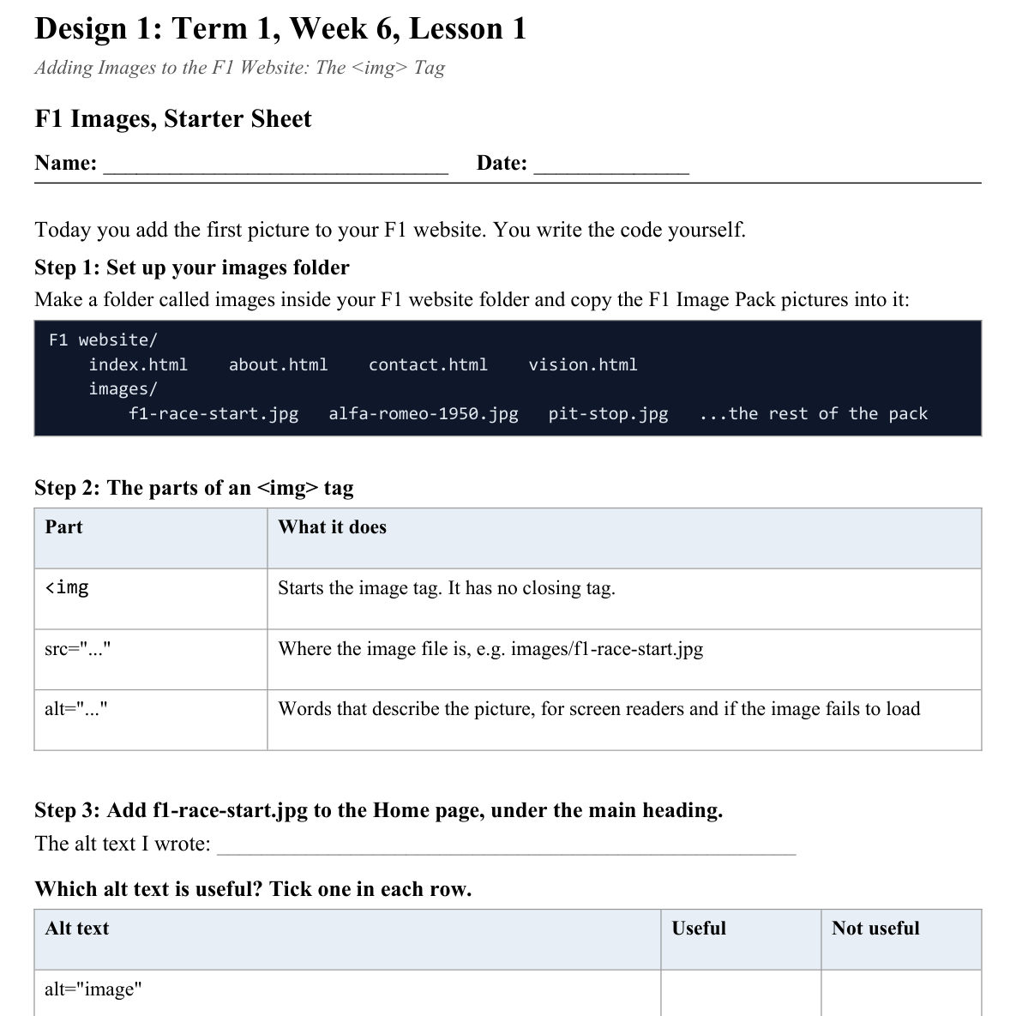
LESSON CORE
You Do: Your First Image
Add f1-race-start.jpg to your Home page.
Write your own alt text, then check it in the browser.
Activity: F1 Images, Starter Sheet
Gradual Release of Responsibility
30 - 40 minutes
3 / 3

Slide 10
CLOSURE
Exit Ticket
Why does an image need alt text even if it looks fine on screen?
Transition & Extend
5 - 10 minutes

